Slide 1
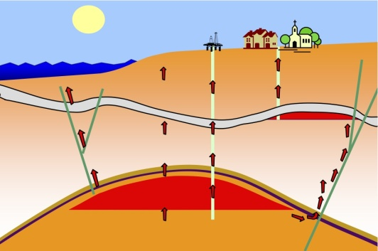
CORA methodologies
Subsidence
Leakage along wells
Leakage through the cap rock
Leakage along fault planes
Lateral Migration:
Famke Kraaijeveld PTI/RC

Slide 2
Subsidence
Leakage along wells
Leakage through the cap rock
Leakage along fault planes
Lateral Migration

Slide 3
Distribution functions & proxys

Slide 4
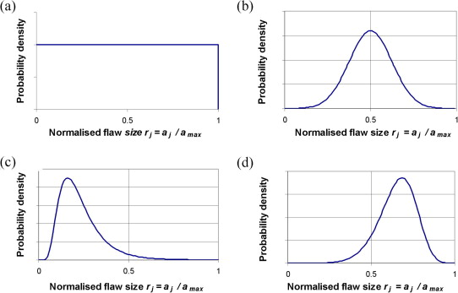
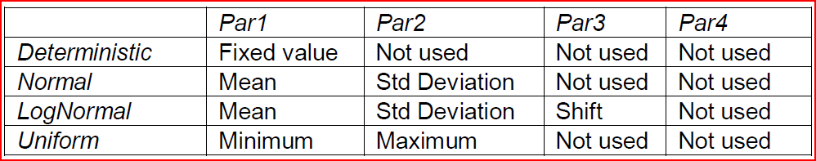
DiStribution functions
Deterministic : No stochastic distribution
Normal : Exponential / Bell shape
LogNormal : Shifted normal distribution
Uniform : Block shape, 1 between min and max value X
TruncatedNormal: Normal with cut-off, s.t. area = 1, i.e. Mean might change
Uniform
Normal
Lognormal
Lognormal

Slide 5
Proxys for responses
FirstOrderProxy P10: Single plane (from P10 and P50)
FirstOrderProxy P90: Single plane (from P50 and P90)
FirstOrderDoubleProxy: Double plane (P10, P50 and P90),
connecting at basecase
SecondOrderProxy: Second order surface (P10, P50 and P90)
ExperimentalDesign: Least square fit of single plane (P10, P50 and P90)

Slide 6

correlations
Source:
http://en.wikipedia.org/wiki/Correlation_and_dependence
Value from [-1,1]
Fully correlated means 1-on-1 relation, i.e. the dependent stochast is known main stochast is sampled.

Slide 7
Reliability methods

Slide 8
Material & Operational failure
Proxies are based on responses
Response = Max, mean, fail area, fail area %
  Failure area and failure area % are the result of material failure
  Material failure is defined as component property, e.g. SCU = 1, S3Min, E1 Max, Uz Max (Uz Max = 0 gives subsidence bowl)
  Reliability is based on operational failure:
  LSF = Z-function = resistance – response
  Resistance = operational limit, e.g. Uz % failure area = 0.2, SCU = 1.1, Uz max
  Negative resistances, tensile failure, might give issues

Slide 9
Reliability methods
Methods:
  First Order Residual Method (FORM) : For best performance
  MonteCarlo (MC): Gives most precise results, but takes lots of time
  DirectionalSampling (DS): Intermediate solution
  ImportanceSampling (MIS): Intermediate solution
  NumericalIntegration (NI): Solution by integrating values, might be added later

Slide 10
Reliability methods
Parameters to control the probabilistic computation
Probabilistic Parameter | Methodology | Description
Seed | MonteCarlo, ImportanceSampling, DiretionalSampling | Seed value for randomizer
Umin, Umax | NumericalIntegration | Minimum and maximum value for u, only used in numerical integration
Intervals | NumericalIntegration | Number of intervals in numerical integration
MinimumSamples, MaximumSamples | MonteCarlo, ImportanceSampling, DiretionalSampling | Minimum and maximum samples in MC, DS, MIS
MaximumIterations | FORM | Maximum number of iterations in FORM
StartMethod | FORM | Start method for FORM, possible values: StartZero, StartOne, StartGivenVector, StartRaySearch, StartSphereSearch
StartVector | FORM | Start values for u in FORM, When supplied, the StartMethod is set to StartGivenVector.
RelaxationFactor | FORM | Relaxation factor for FORM
VarianceFactor | MonteCarlo, ImportanceSampling | Variance factor for Importance Sampling
VariationCoefficientFailure, VariationCoefficientNoFailure | MonteCarlo, ImportanceSampling | Required variation coefficient for failure and non failure
Threshold Relaxation Factor | All | Relaxation factor for lowering the threshold for switching between the proxy and the real engine

Slide 11
form
  Estimated by
    transfer to normal distributions
    Linearized z-function
  Fast

Slide 12
Crude monte carlo
  “Random sampling”
  P = # failed/ total
  Stops when variance small (convergence) or max samples
  Most precise

Slide 13
MC Importance sampling
  Sampling towards failure cases
  P = weighted (# failed, total)
  Stops when variance small (convergence) or max samples
  Captures local minimum, i.e. requires pre-knowledge

Slide 14
MC directional sampling
  Sampling in directions to find failure plane
  Probability from transfer to nomally distributed PDFs
  Assumes LSF function) monotone and smooth
  Faster than crude

Slide 15
Numerical integration
  Sampling by discretizing the stochast
  Probability of failure from summation of all failure combinations

Slide 16
Automatic switch in reliability methods
When LSF = Resistance - Response < Threshold then
Switch to engine
Update proxy
Lower threshold by 2/3
Note:
  Threshold = 0 means only proxy calculations
  Factor could be made input parameter
  Update proxy y/n could be steered from xml

Slide 17
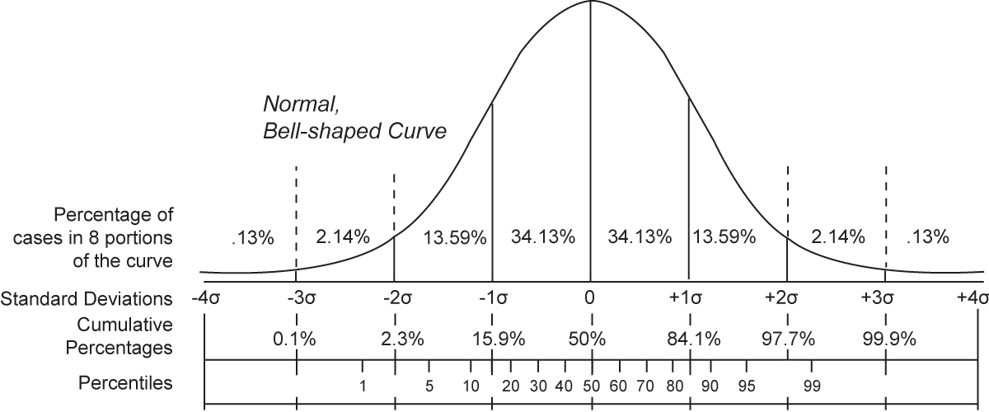
Reliability results
Reliability:
  Beta
  Probability of failure
  Design point
  FORM: direct;
  MC: centre of gravity or methods of angles
  In u-space (standard Normal distributions)
  Defined by
    Alpha: coefficient
    U: normalized design point
    X: design point
Notes:
Standard normal Bell-shaped curve and the associated standard deviations and
cumulative percentiles. The reliability index is represented by the Standard
Deviations.

Slide 18
System reliability
Failure occurs if one or more components fail: series of components
If components are independent:
P_{Fail} = 1 – (1-P_{F1}) * (1-P_{F2})
Failure occurs only if all components fail: Parallel system of components
If components are independent:
P_{Fail} = P_{F1}* P_{F2}
1
1
2
2
≈ P_{F1} + P_{F2}
If P_{F1} and P_{F2} are small
1
2
3
If components are independent:
P_{Fail} = P_{F1}* [1 – (1-P_{F2}) * (1-P_{F3})]

Slide 19
System reliability
System reliability based on combined response surfaces
  Directional sampling
  Using design point per component
  When components are independent and have probability of non-failure of P1, P2, ..., then system failure equals
  Probability of failure = 1-(1-PF1)*(1-PF2) *… = P_{F1} + P_{F2}+ ...
  Probability of non failure = P1*P2*…
Reliability (Test03dualzoneproducinginterval1.Initial.Initial.Resistance=0Test03dualzoneproducinginterval2 .Initial.Initial.Resistance=0, (MonteCarlo)
 | Test03dualzoneproducinginterval1 .Initial.Initial | Test03dualzoneproducinginterval2 .Initial.Initial | System
Beta | 0.410664445 | -0.25696902 | -1.751071457
Probability of failure | 0.340659341 | 0.601398601 | 0.960033242
Probability of non failure | 0.659340659 | 0.398601399 | 0.039966758

